Slide 1
Medicine Shop Automation System
Department of Computer Science and Engineering
National Institute of Technology, Rourkela
Koshal Kumar Garg (114CS0100)
Dibya Ranjan Mishra(114CS0108)

Slide 2
Purpose
Medicine Shop Automation (MSA) is required to ease the workload of medical shop professionals. The main features include stock management, accounting, client management. Integration with doctors allows getting prescriptions instantly, ordering medicines from suppliers

Slide 3
Features
Inventory/stock management
Accounting
Direct supply of medicine with sync with doctor’s prescription
Notification of prescriptions by doctors to the respective shop owners
Order placement
Globally accessible
Viewing previous purchases and prescriptions by the patients.

Slide 4
Programming Languages and Tools Used
Programming Languages:
HTML
CSS
BOOTSTRAP
JAVASCRIPT
PHP
Database:
MySQL
Tools:
Xampp
Sublime Text Editor

Slide 5
Operating Environment
Web browser
Internet connection
Desktop/laptop (recommended).
Platform independent.

Slide 6
User Classes and Characteristics
Medicine Shop owner(Retailer)
Supplier
Doctor
Customer

Slide 7
Functional Requirements
User Authentication (Common for all users)
For Shop Keepers:
Sell / Create bill
Order medicines from suppliers
Customers Account Handling
Managing Prescriptions by different doctors
For Doctors:
Prescribe
View previous prescriptions

Slide 8

Functional Requirements
For Customers/Patients:
View previous bills
View previous prescriptions
view list of shop owners he has purchased earlier as well as credits for each shop owner
For Suppliers:
Add new medicines
Supply medicines according to orders from different shop owners.

Slide 9
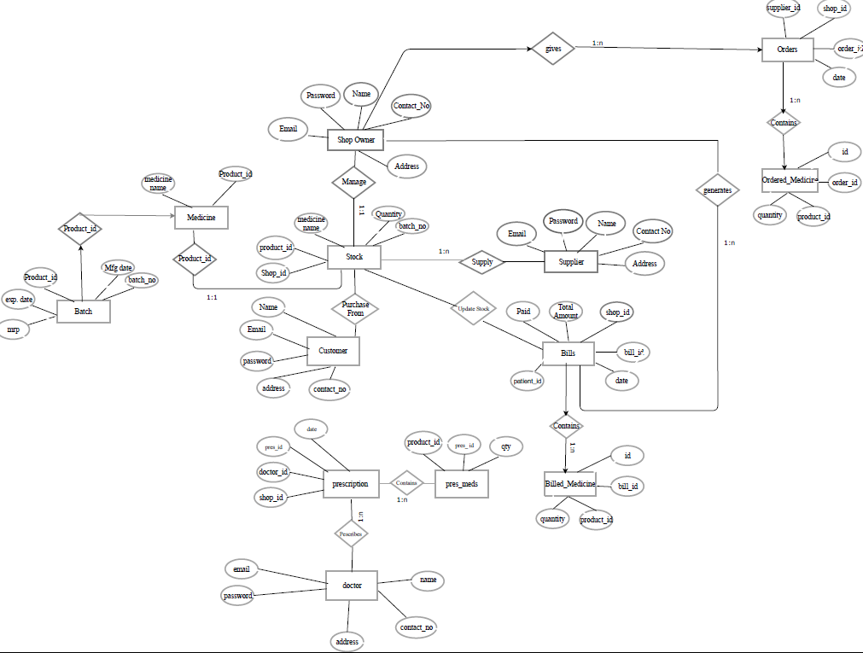
ER DIAGRAM

Slide 10
DFD (Level 1)

Slide 11
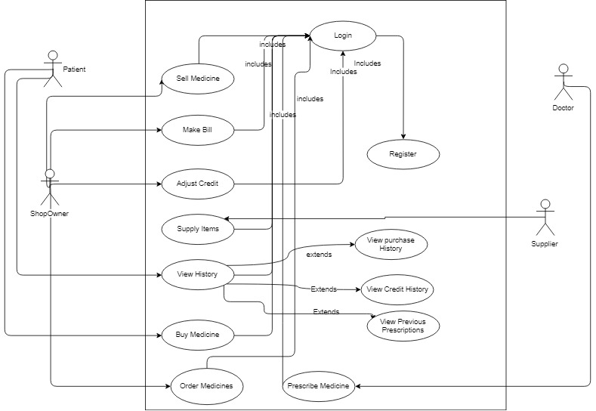
Use Case Diagram

Slide 12
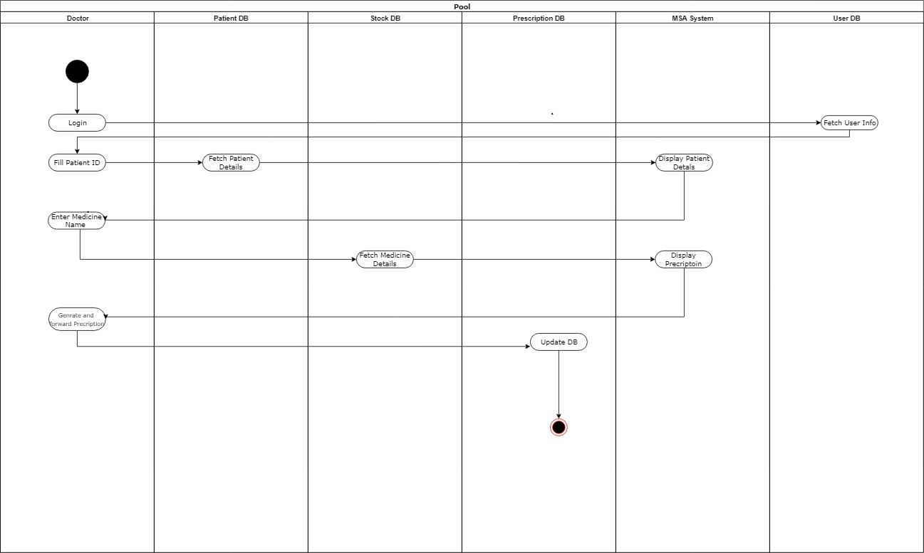
Activity Diagram

Slide 13
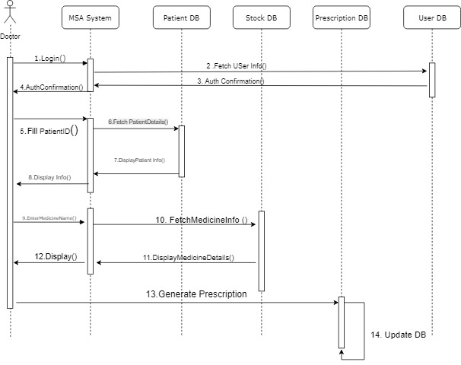
Sequence Diagram

Slide 14
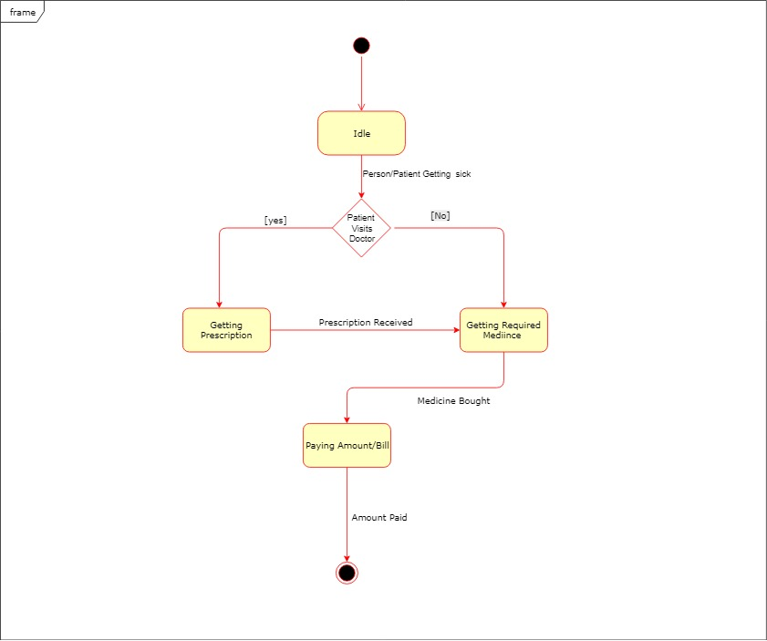
State Chart Diagram (For Patient)

